Slide 1
Midterm Proposal
Mahindra Persaud

Slide 2
Idea
Professional Website
Showcase resume in an interesting and easy to read format
Custom Icons

Slide 3
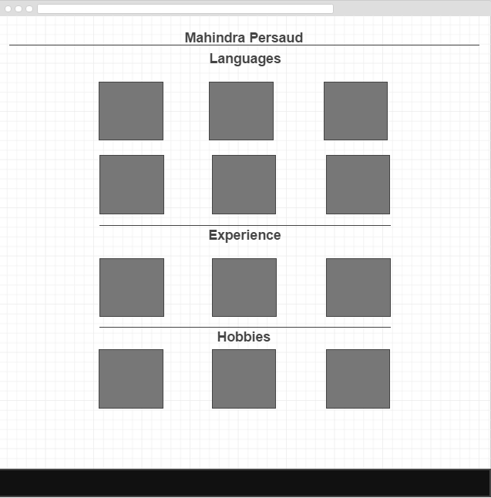
Home Page

Slide 4
Attempting for Final Design
Each project in Language will link to the project
Each work experience will link to where I worked and who I worked for, what I did there, what I learned, what I experienced.
Each Hobby will link to slideshows with small little captions of where I was and a bit about the image that is displayed.
Hobby page will have an additional hobbies section at the bottom with additional hobbies not added into the main page.
Create a game that lets the user learn about me as they play. Will be done much much later and provide user with the option “Do you wanna play a game?”

